Slide 1
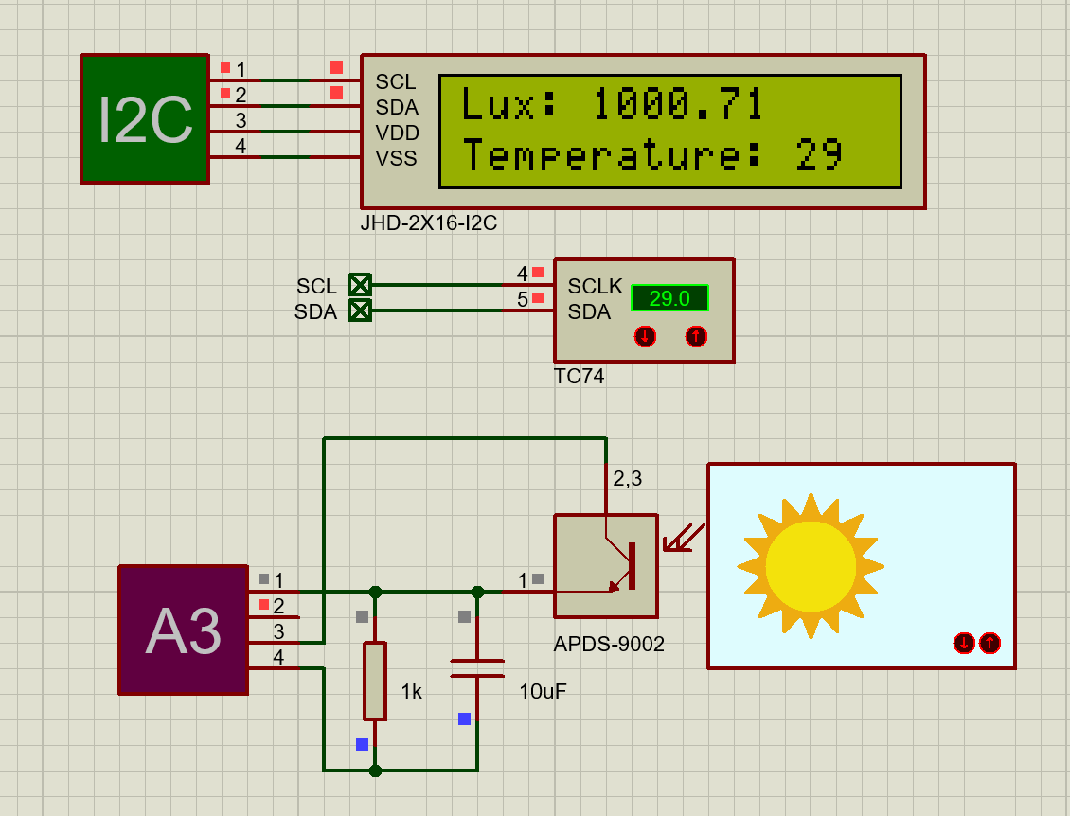
Functions —— Light Intensity
Functions —— Temperature
Light Intensity
Temperature

Slide 2
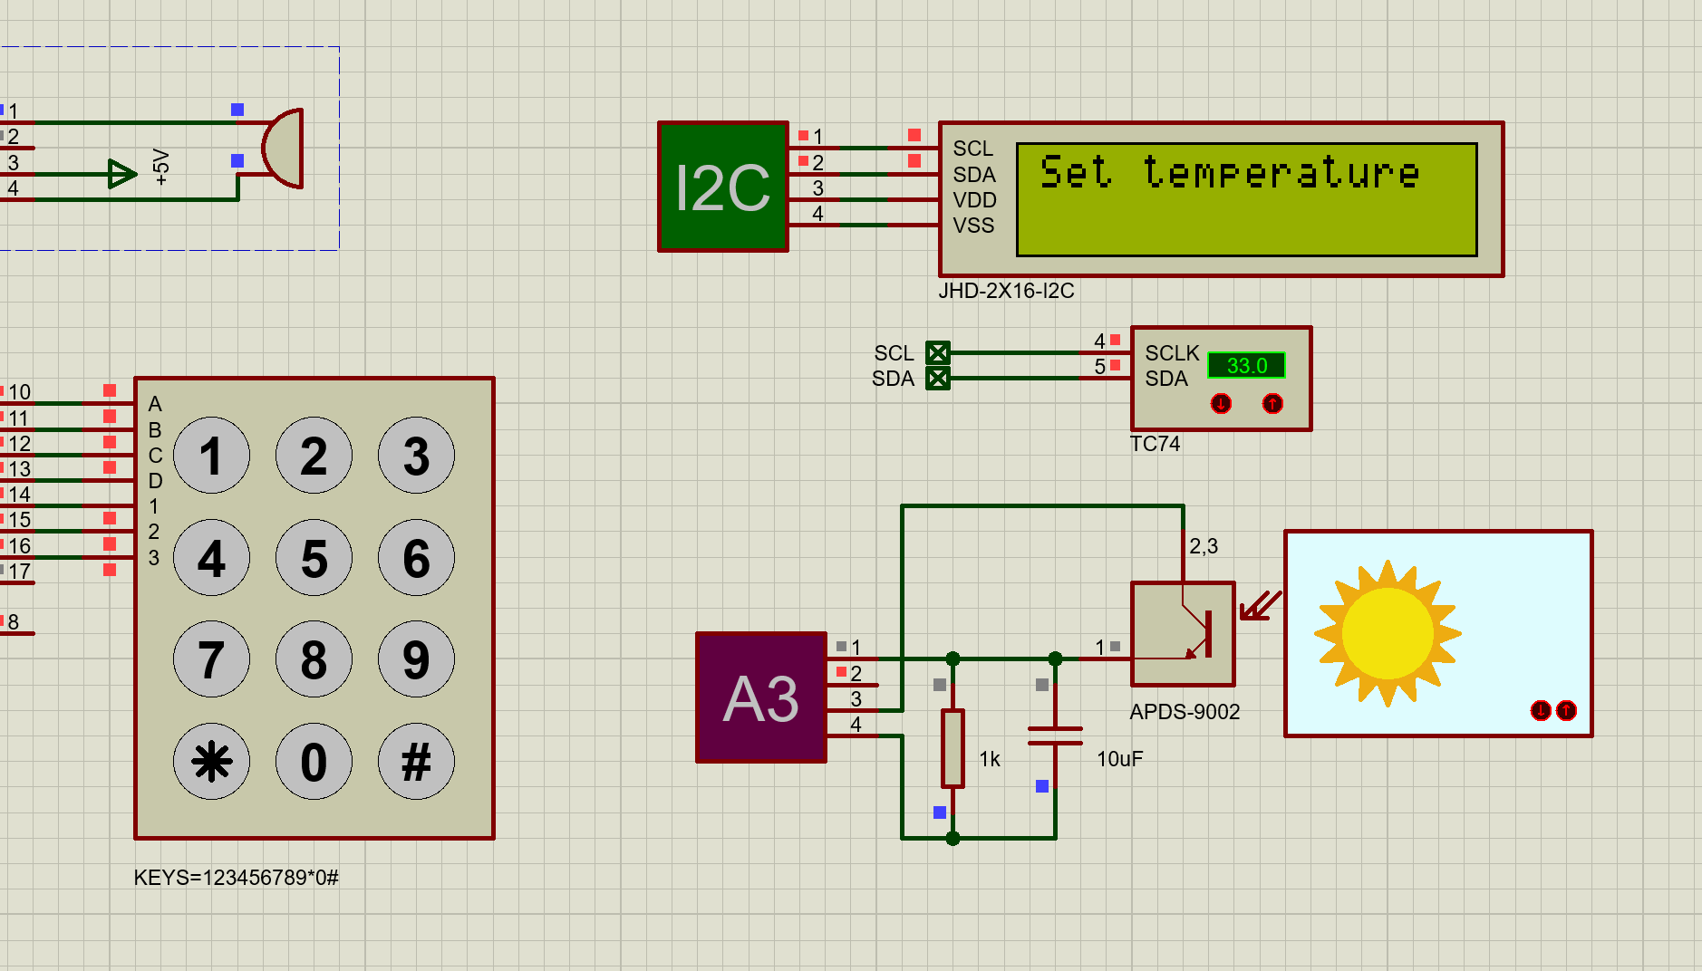
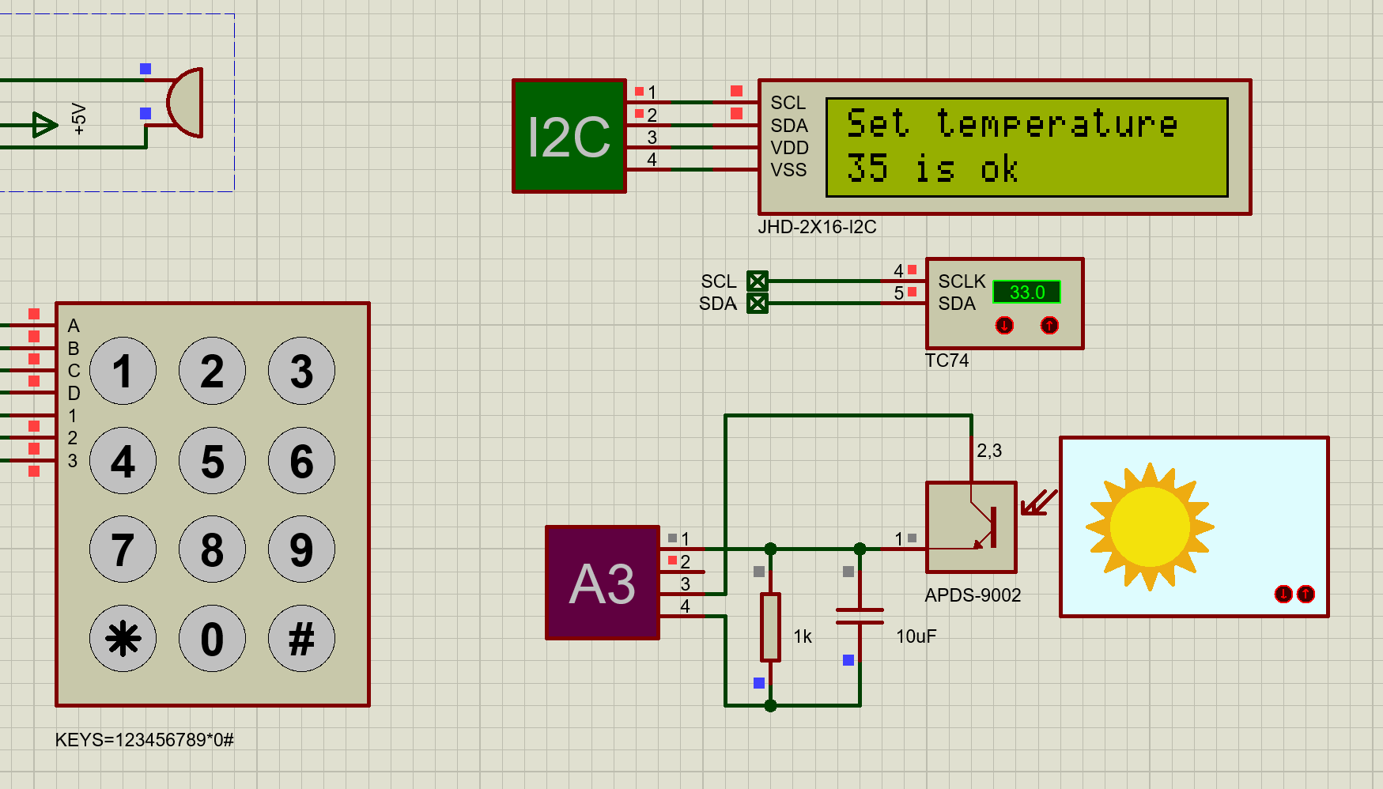
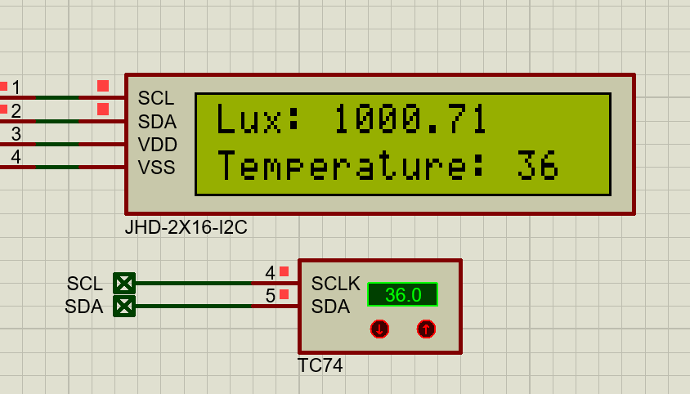
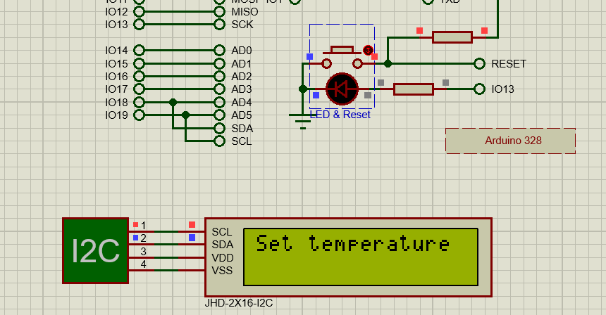
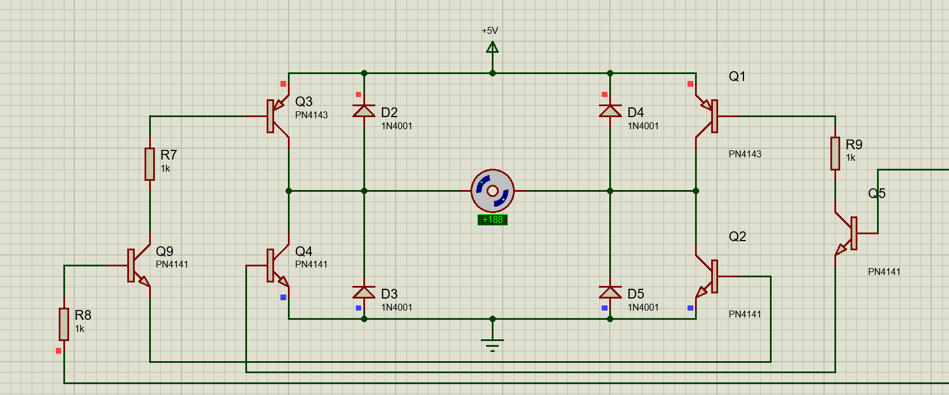
Functions —— Threshold Temperature & Fan
Threshold Temperature: 35℃
Current Temperature:
33℃
Current Temperature:
36℃
Set Threshold Temperature
Reset Threshold Temperature
36℃ > 35℃
Fan

Slide 3
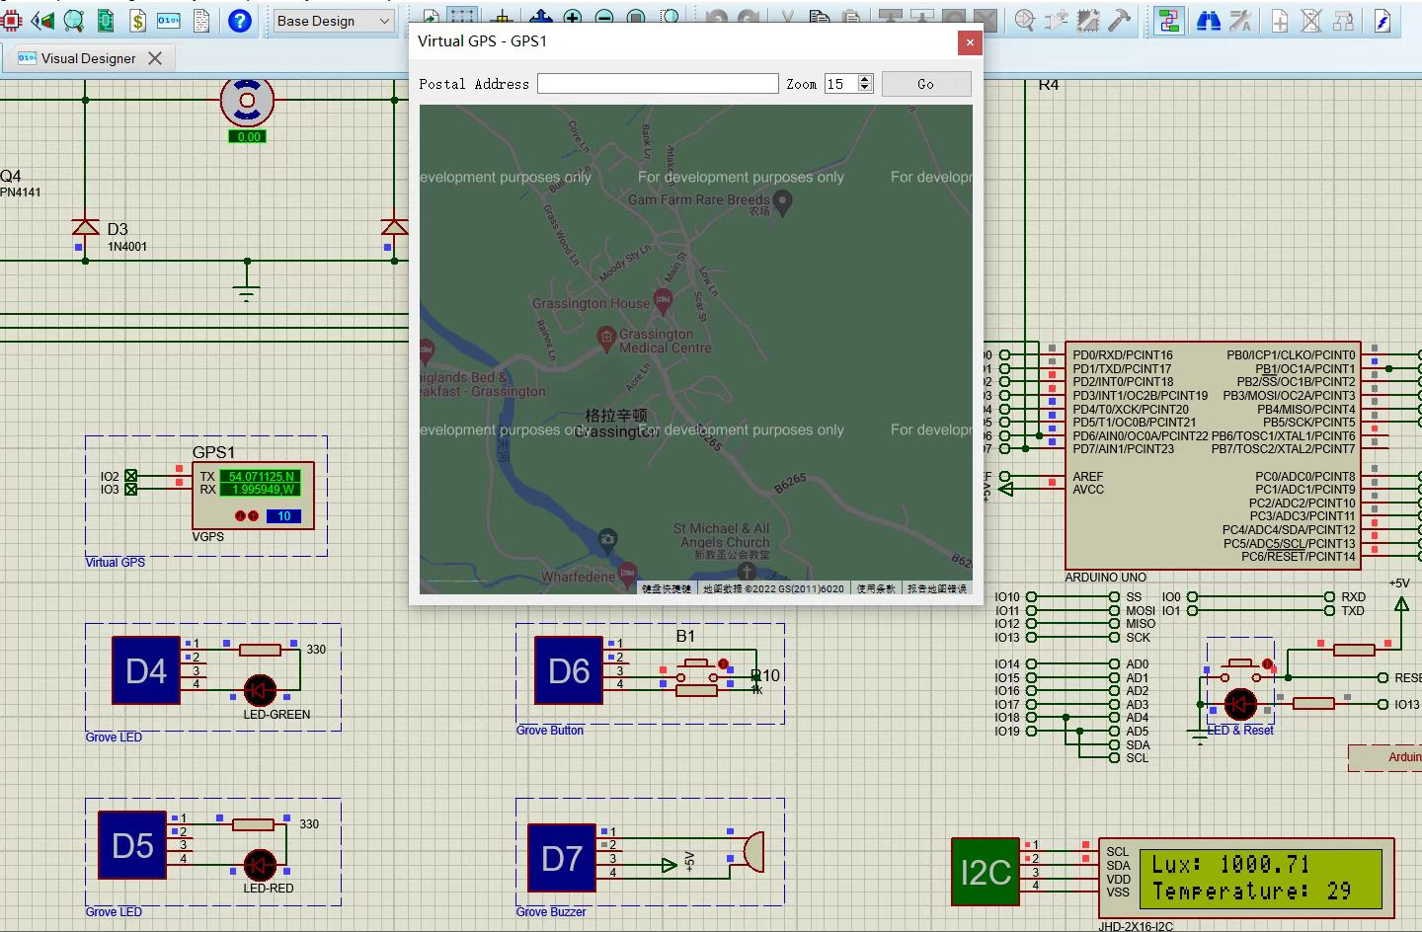
Functions —— GPS
GPS

Slide 4
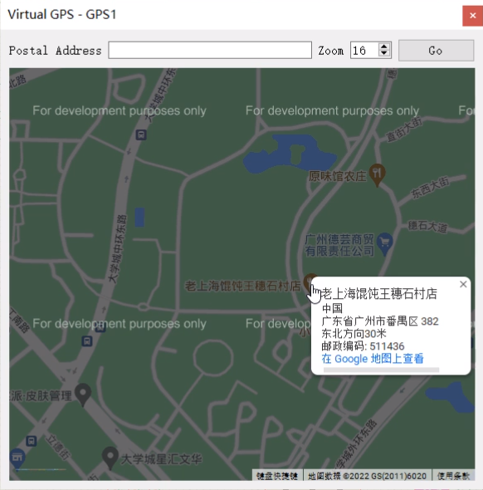
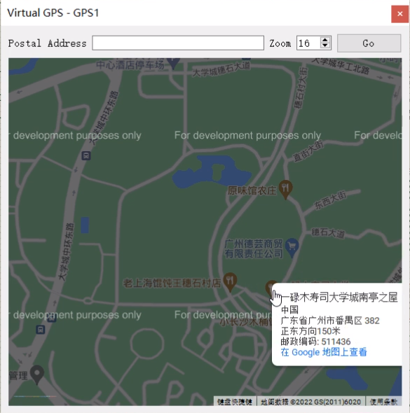
Functions —— GPS

Slide 5
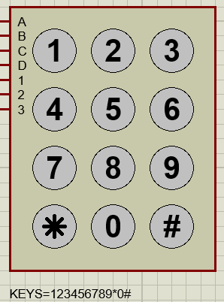
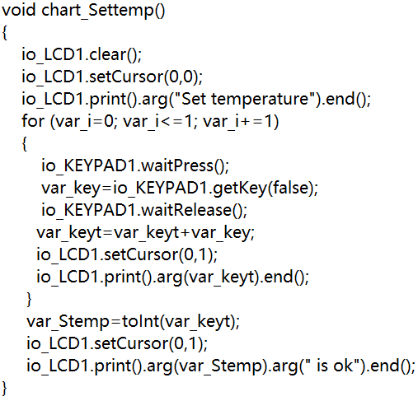
Code Interpretation
——Set Threshold Temperature

Slide 6
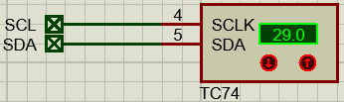
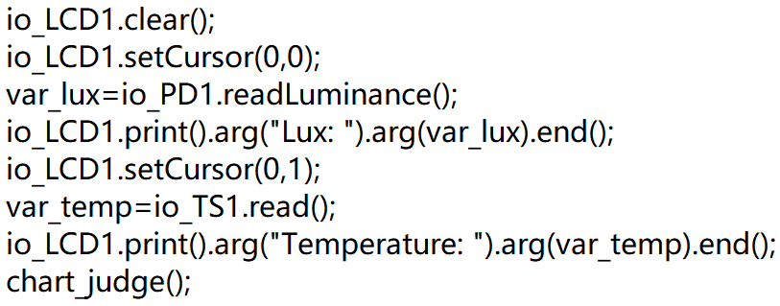
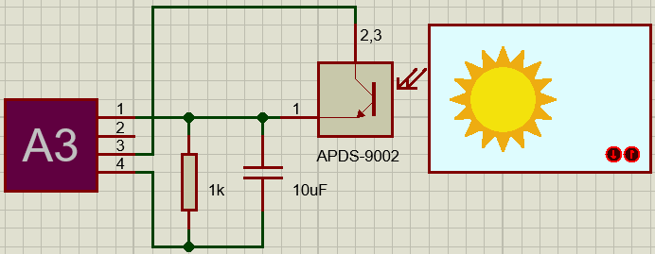
Code Interpretation
——Display the Light Intensity and Temperature

Slide 7
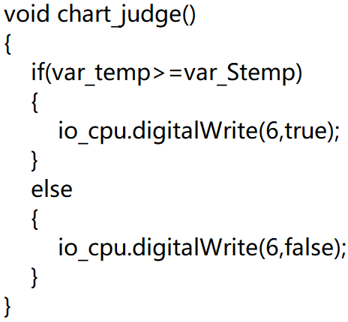
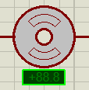
Code Interpretation
——Control the Fan’s ON / OFF

Slide 8
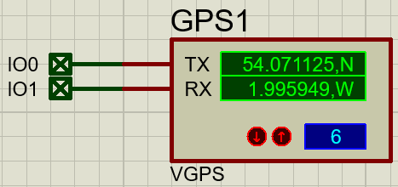
Code Interpretation
——GPS
Latitude
Longitude
Zoom

